Slide 1
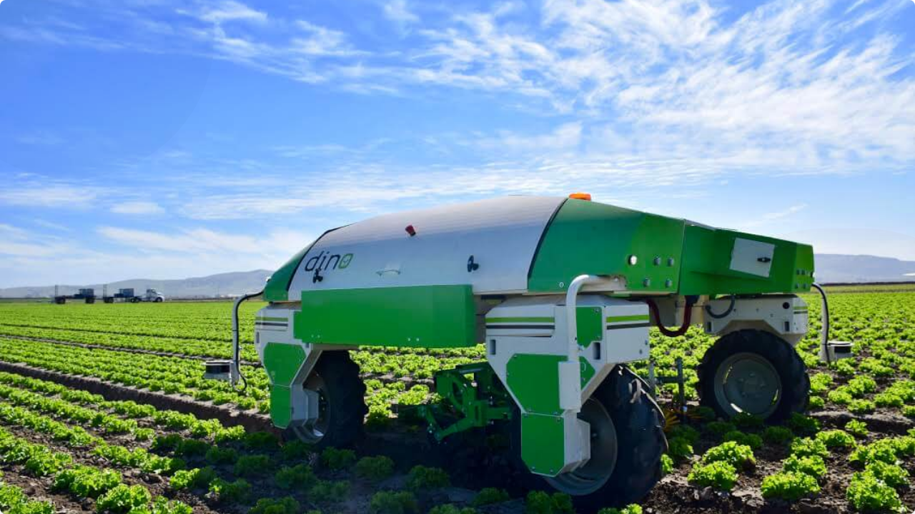

Research Methodology: A Dual-Mode Autonomous Weeder Robot
Adithya Pothula, Siddanth Bhogoju

Slide 2



Introduction & Problem Statement
Introduction
The Problem Statement
Precision agriculture demands intelligent tools to manage farm resources efficiently. Weeding, a critical task, remains a major bottleneck.
1. Labor Intensive: Manual weeding is slow, physically demanding, and increasingly expensive due to labor shortages.
This research focuses on developing an autonomous robotic system to differentiate crops from weeds and perform targeted removal, addressing the limitations of current methods.
2. Inefficient: Broad-area chemical spraying is non-selective, costly, and leads to herbicide resistance and environmental damage.
3. Technology Gap: No single, high-speed platform effectively integrates both mechanical (physical) and chemical (spot-spray) weed removal methods.

Slide 3






Literature Review: Key Findings
Weed Detection
Navigation (SLAM)
Removal Mechanisms
The field has shifted from simple color and shape analysis to robust Deep Learning models (CNNs, YOLO). These provide real-time, all-weather detection, even with occlusions.
Cartographer and other sensor-fusion SLAM (LiDAR + IMU) are proven superior for the semi-structured and uneven terrain of farms, enabling accurate localization.
A clear gap exists. Mechanical methods are eco-friendly but risk crop damage. Precision chemical spraying is fast but risks drift. A hybrid approach is needed.

Slide 4

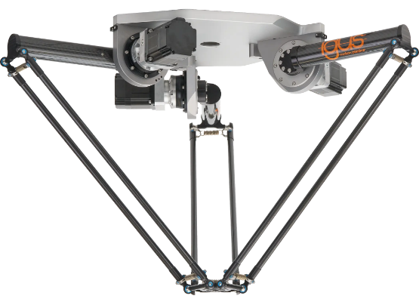
Proposed Solution: A Dual-Mode AMR
Our Solution
We propose a 3-DoF Delta Robot AMR that intelligently combines two removal methods in one system:
•
High-Speed Platform: A 3-DoF Delta parallel manipulator provides rapid, precise positioning over the target area.
•
Dual-Mode End-Effector: A single, compact toolhead integrates a servo-electric gripper (for mechanical removal) and a micro-spray nozzle (for targeted chemical application).
•
Unified Control Stack: The system is managed by ROS2, using MoveIt2 for motion planning and YOLOv8 for real-time perception.

Slide 5
Research Methodology & Workflow
4. Execution
2. Localization
The controller manager activates the appropriate tool (gripper or nozzle). Model Predictive Control (MPC) compensates for actuator and fluidic delays.
The 2D weed detection is fused with 3D LiDAR data. Using ROS2 tf2 transforms, the system estimates the precise 3D position of the target weed.
1. Perception
3. Planning
On-board camera captures images. A trained YOLOv8n model processes the feed to detect and classify weed bounding boxes in real-time.
MoveIt2 motion planner computes a collision-free trajectory. As the arm approaches, MoveIt Servo provides real-time visual servoing for fine-tuning.

Slide 6
Questions?
Thank you for your attention.
Adithya Pothula | Siddanth Bhogoju

Slide 7



Image Sources
https://rbtx.it/_next/image?url=https%3A%2F%2Fimages.cdn.europe-west1.gcp.commercetools.com%2Fe6e8fb78-82fb-4fc9-8ac7-7ac06b850514%2FLCA_PROD_XXL_delta_r-7gWEtXnp.png&w=3840&q=75
Source: rbtx.it
https://modernfarmer.com/wp-content/uploads/2020/02/0-1.jpg
Source: modernfarmer.com

